Slide 1

Micro Data Analysis Using Micro Data at Statistics Bureau
Conference on Introduction to Data and Resources
Available at Statistics Bureau Japan
At Nuffield College, Oxford, Jan 9th 2020
Nobuko Nagase PhD
Professor of Labor Economics, Advisor to President,
Ochanomizu University、 お茶の水女子大学

Slide 2
A Large Very High Quality Data Sets as Anonymous Japanese Data
Japanese Statistics Bureau’s Governmental data is very high in quality, and also of a very large scale.
The process of borrowing the data is tiring, be patient as it is worth going through the process due to the high quality and the large sample size.
Anonymized data is user friendly as it is already in stata form.
I have been mostly analyzing Japanese governmental data, or my own made data with competitive funds. I have used various data, but the quality of governmental data is very high compared with small data sets made by researchers, though small data sets had their own good in the interesting questions.
All the following analysis that I will show has anonymized data sets.

Slide 3
Today I will be showing you some of my work or my group’s work on data that has anonymized data set
1. Labour Force Survey
2. Employment Status Survey
3. National Survey of Family Income and Expenditure
4. Comprehensive Survey of Living Conditions
5. Survey on Time Use and Leisure Activities

Slide 4
1. Labour Force Survey Statistics Bureau
For example, Labour Force Survey, monthly survey, and also rotating panel of consecutive two months and then consecutive two months a year later.
http://www.stat.go.jp/english/data/roudou/index.html
Interesting data. Even though many of my papers are in Japanese, I will list a few in English.
Nagase, Nobuko （2018）“Has Abe’s WOMANOMICS worked?” Asian Economic Policy Review 13(2) 68-101.
This paper exploited monthly data structure to look at the effect of Womanomics which started in 2013 January, to look at the effect on maternal labor participation, work hours of males and females, and of income of males and females after taking into account of increase in day care center provision.

Slide 5
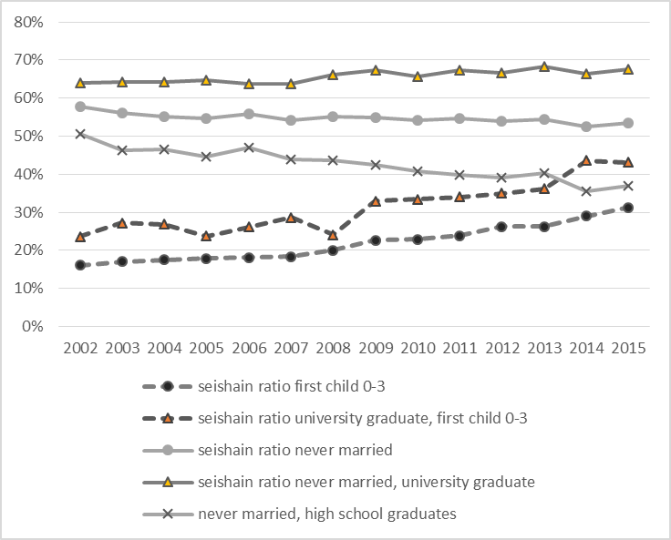
Has Female in Pipeline for Long Term Employment Increased?
Women Seishain ratio among all women by education and marital status age 25-39
For never married university graduate, only a small improvement.
Much improvement for female with a young child,
especially, university graduate
Deterioration for never married high school graduate.

Slide 6
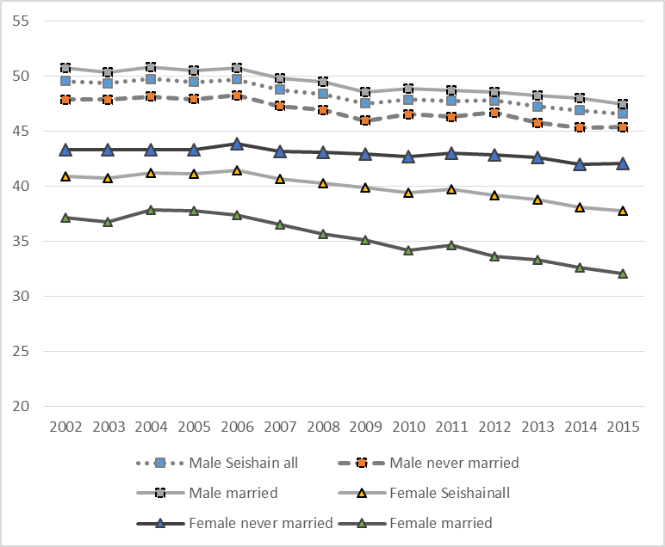
Has Work Hour Decreased? -- yes
Work Hour of Long Term Employee, Seishains, Age 25 to 39
Work hour decreased somewhat for male seishain
Work hour decreased substantially for married female seishain

Slide 7
Ratio of Two-Year-Old child care places to child population can increase when population decrease. Therefore, growth rate of infant care should also be added as child supply index
Growth rate of 2 year old was low in urban area despite low supply in early 2000s because these municipalities had additional cost as many child care was publicly run .
Ratio of Growth in Registered Child Care Places for Age Two
Growth rate of 2 year old from 1990s to 2007 relatively high in rural area due to declining number of children. Perhaps to keep child care facilities, infant care was enlarged

Slide 8
Labor Participation of Married Females aged 25-54 by Probit Analysis and Policy Effect
Strong increase in labor participation of women with small children

Slide 9
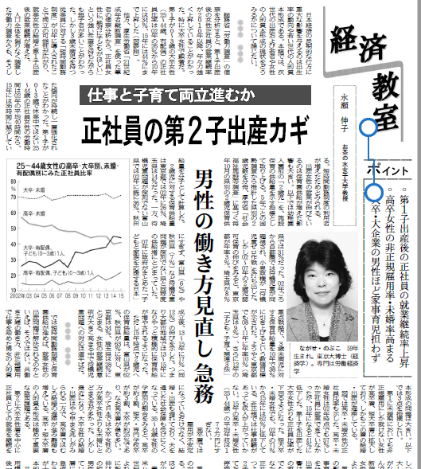
Nikkei Newspaper Economic Class 経済教室

Slide 10
Income Contingent University Loan Simulation
Shiro Armstrong, Dearden Lorraine, Masayuki Kobayashi, Nobuko Nagase(accepted 2018 Oct) “Student Loans in Japan: Current Problem and Possible Solutions” Economics of Education Review
This paper used Labor Force Survey as it is the most recent and representative labour survey university graduates’ income data of individuals and also of couples in Japan.
Labour Force Survey only has “earnings blackets”, unlike US Current Population Survey that reports exact earnings, so estimation simulation method was used to do quantile regression of 1 % to 99 %.
We did simulation on specific structure of income contingent student loan while looking at Australian and UK student loans, to see what income contingent structure would be successful to Japanese university graduate labor market.

Slide 11
Rising percentage of students entering university
Source:

Slide 12
And Rising Percentage of Students with Student Loan
Student loan according to JASSO study Gakusei Seikatsu Chosa , student going to 4 year univ day course

Slide 13
Who has JASSO student loans? Using JASSO 2014 student survey
Prefectural public universities and those living away from home are more likely to have JASSO loans
Lower income households are more likely to have JASSO loan

Slide 14
Average JASSO Debt
Average outstanding debt
2016
Type 1 Loan (Without Interest rate, higher grades required)
2.36 million yen ( around $30,000 )
Type 2 Loan (with interest rate levied, standard score required)
3.43 million yen (around $43,000 )
Repayment Model Case
For Type 1 , monthly loan of 54000 yen (675 Aust Dollar/month),
Repayment 14400 yen/ month for 15 years ($180 /month)
For Type 2 , monthly loan of 80000 yen,(1000 Aust Dollar/ month)
Repayment 16270 yen/ month for 20 years ($203 /month)
Minimum Wage Japan vs Australia 10.6 $ (848 yen) vs 18.93 $ about double in AUST
Source : JASSO Home Page

Slide 15
3. Quantile Regression of University Graduated Males and Females age 23-65 --a very large gender gap
Annual income
10,000 yen
Annual Income
10,000 yen

Slide 16
By Quantile, how much will be repaid by ICL, by using income distribution, and supposing that one stay in the same quantile
Assumption:No Dynamics, people stay in same quantile

Slide 17
3 Types of Households each by Quantile, BA married to BA,BA married to non-BA, and Single
30 percentile
Male Female
Bottome 30 percentile, single male BA
Bottome 10 percentile, single female BA

Slide 18
3 Types of Households each by Quantile, BA married to BA,BA married to non-BA, and Single
Bottome 30 percentile, male BA married to non-BA female
30 percentile
Male Female
Bottome 30 percentile, female BA married to non-BA male

Slide 19
3 Types of Households each by Quantile, BA married to BA,BA married to non-BA, and Single
Bottome 10percentile BA female married to BA male
10 percentile
Male Female
Some low income females married may belong to relatively stable income households.

Slide 20
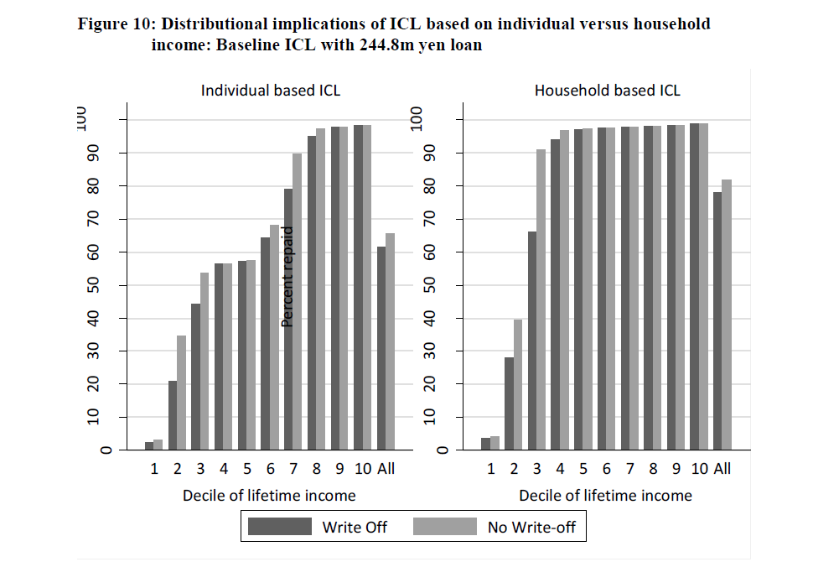
When Levied on Households, the results are better, when income dynamics are taken into account, individual levy fair better.

Slide 21
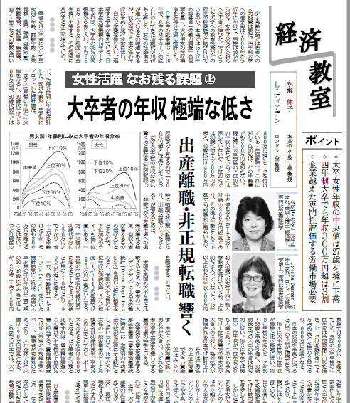
Nikkei Newspaper Economic Class 経済教室

Slide 22
Nobuko Nagase(2011) “Structural Change in Unemployment by Gender in 2000’s using the Panel Structure of Labor Force Survey, (2000 nen igo no Danjo no Shitugyo Kozo no Bunseki—Rodoryokuchosa no paneru kozo wo mochiite Kozo Henka wo Bunseki suru,” Tokei to Nihon Keizai ( Statistics and the Japanese Economy) Vol.1 No.1 pp.91-111 (in Japanese).
永瀬伸子（2011）「2000年以後の男女の失業構造の分析 –労働力調査のパネル構造を用いて構造変化を分析する–」『統計と日本経済』第1巻1号 91-111頁。
The above paper used panel structure of Labour Force Survey to look at the changes in employment to non-employment, employment to unemployment etc as one months as well as one year transition.

Slide 23
2. Employment Status Survey Statistics Bureau
Employment Status Survey, a representative Survey conducted every five years. A very large scale, 490,000 dwellings for example, that you may, for example, easily can find twins.
http://www.stat.go.jp/english/data/shugyou/index.html
Due to its large numbers, and more detailed questionnairs compared to Labor Force Survey, many labor papers in Japan are written using this data, especially in economics field.

Slide 24
One of my PhD student used anonymized data to survey the change in female clerical jobs, and got good paper Population Association Japan prize.
Only this large scale and representative national data set was able to verify what she has tried to do.
Eriko Teramura(2012 ) “ Estimation of Wage and Labor Supply for Japanese Female Clerical Workers Post the Equal Employment Opportunity Law ―Comparative Analysis for 1992,1997,and 2002― , Jinkogaku Kenkyu (The Journal of Population Studies )Vol48 p6-22. (in Japanese, can be found in J-stage) https://www.jstage.jst.go.jp/article/jps/48/0/48_KJ00009388804/_article/-char/ja/

Slide 25
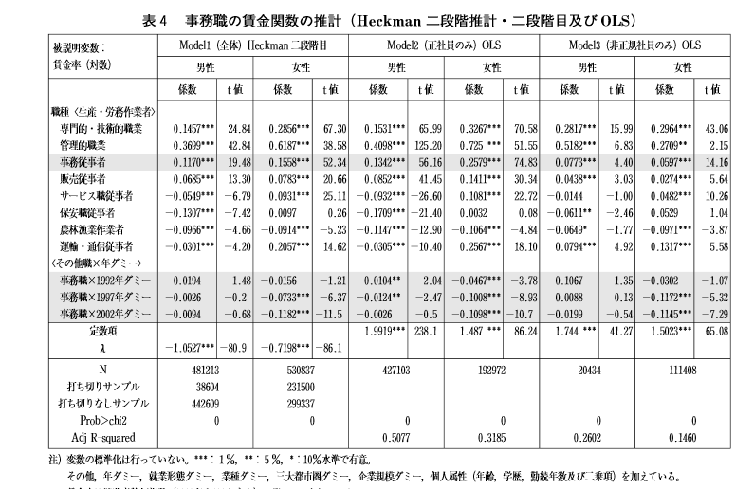
Eriko’s Paper

Slide 26
3. National Survey of Family Income and Expenditure, Statistics Bureau
National Survey of Family Income and Expenditure
http://www.stat.go.jp/english/data/zensho/index.html
A unique survey that covers about 5500 households, with detailed expenditure three month average and income.
I used this data to do micro-simulation for Cabinet Office Gender Equality Bureau with Kazumitsu Nawata and others in 2003.
Due to its detailed income data by different sources, and of all family members, we made tax and social security calcuration for all households and predicted the change in law what would happen should tax law and social security law concerning part-time working females had changed.
http://www.gender.go.jp/kaigi/senmon/eikyou/siryo/pdf/ei29-5.pdf
Working Team Report for Gender Equality Bureau in 2004 July 1st by Nobuko Nagase, Kazumitsu Nawata, Yuko Murao and others.

Slide 27
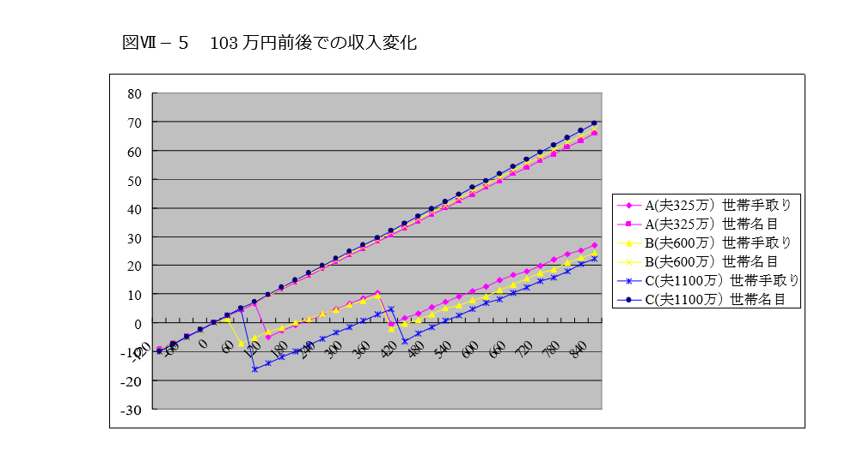
Working Team Report for Gender Equality Bureau in 2004 July 1st by Nobuko Nagase, Kazumitsu Nawata, Yuko Murao and others.
Effect of Tax and Social Security Income Tax on different Households, three households are illustrated, but we had such simulations for 55000 households.
Working Team Report for Gender Equality Bureau p.42.

Slide 28
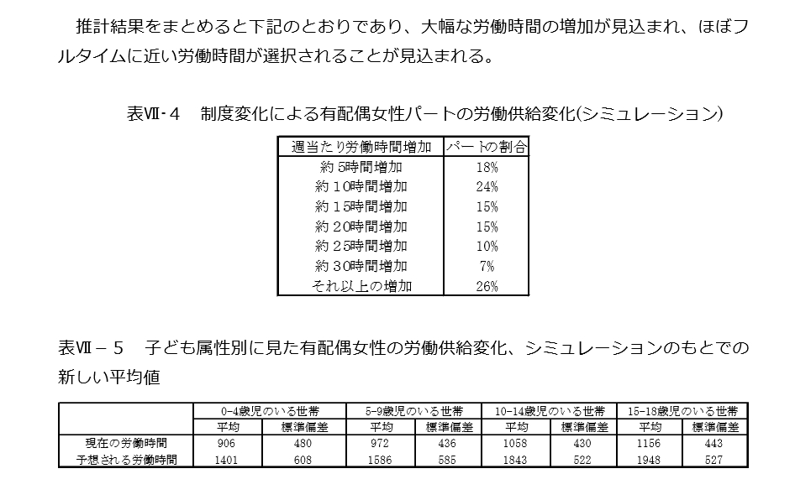
Working Team Report for Gender Equality Bureau p. 45. with Nobuko Nagase, Kazumitsu Nawata , Yuko Murao and others.
The effect of change of income tax and social security tax that has been working to discourage married women to work.

Slide 29
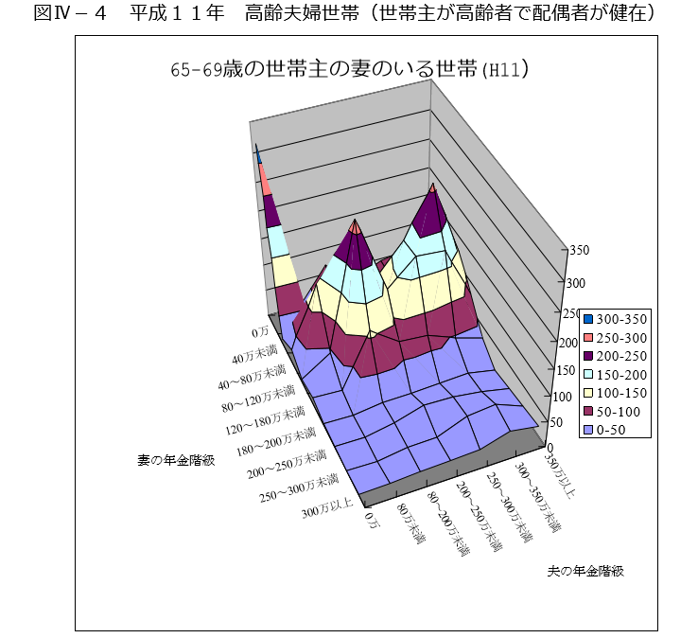
Working Team Report for Gender Equality Bureau with Nobuko Nagase, Kazumitsu Nawata , Yuko Murao and others in 2004.
Public Pension Distribution by Husbands Pension Blacket and Wife’s Pension Blacket.

Slide 30
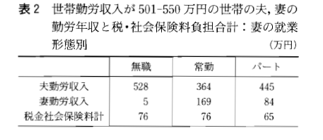
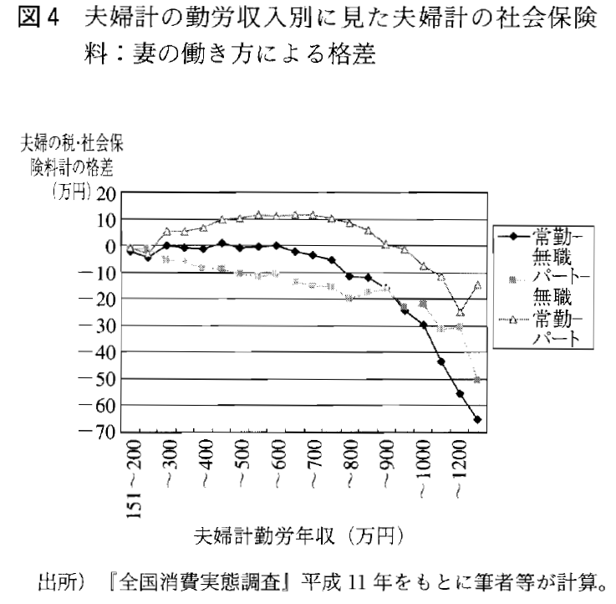
永瀬伸子・村尾裕美子（2005）「社会保障や税制等は家族・家族形成に影響を与えるか－日本の社会的保護の仕組みが持つ特定タイプの家族へのバイアス」『季刊社会保障研究』第41巻2号137－149頁。
分析をしたところ、年収600万未満では合算課税が成立し、専業主婦世帯でも共働き世帯でも、税制面を含めて負担が同一とわかった（図４）。なお年800万円以上になってくると税率が上がり専業主婦世帯（1人だけが高い収入）の方が、共働き世帯よりも税負担が重くなっている。
表２はその具体例である。年収501-550万の世帯を妻の働き方別に平均収入、平均税負担を出したものである。表２のとおり夫婦常勤世帯は一番労働時間が長く担税力が低いとみられるが社会保険・税負担は専業主婦世帯と同一である。

Slide 31
I also estimated cost of children using Engels’ function, and changes in savings structure using similar data.
Nobuko Nagase(2001) “Estimating the Cost of Children from Household Consumption Survey and Household Asset Survey,” Jinkogaku Kenkyu ( The Journal of Population Studies ) No.28 pp.1-15. (in Japanese, can be found in J-stage)
https://www.jstage.jst.go.jp/article/jps/28/0/28_KJ00009385083/_article/-char/ja

Slide 32
4. Comprehensive Survey of Living Conditions Ministry of Health, Labor and Welfare
Conducted every year
Every Three Years a large sample survey is made.
Has detailed Household Survey about work status and insurance coverage, as well as health survey.
Part of the survey has detailed income survey, and part of the survey has detailed old age care survey.

Slide 33
One of my PhD student used anonymous data to study elderly care of non-married singles, especially the difference between daughters and sons. Since it should be large data to capture non-married son’s care activities, the anonymous data worked well.
http://www.lib.ocha.ac.jp/oab/42seikatsu/2016-11-21.html
Nozomi Chiwaki (2016) “Influence of Long-term Care Provisions on the Employment Choice of Coresident Unmarried Children,” Journal of social sciences and family studies, No.23 31-40 ( in Japanese, the web site as follows).
http://www.lib.ocha.ac.jp/oab/42seikatsu/2016-11-21.html

Slide 34
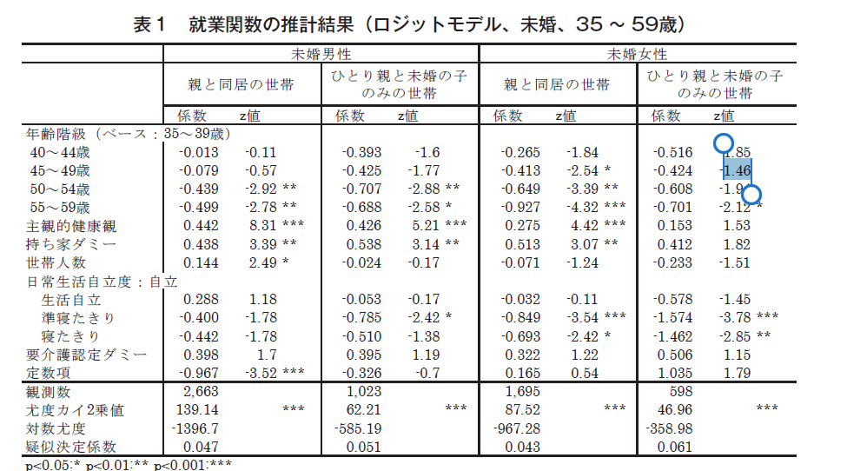
Chiwaki used
following data
Single never married
Living with single
Elderly, do they
loose job?
D

Slide 35
5. Survey on Time Use and Leisure Activities Statisitics Bureau
Gen Time group is doing much research using this data, so I will not go in details.

Slide 36
Study of Japan using Japanese anonymized and on-site data
My interest in Japan is in the gender wage gap, family structure, elderly care, and in fertility.
I see some similarity and differences between other developed countries and also between East Asian countries.
I hope you will enjoy the interesting journey of adventures using the Japanese data.

Slide 37
Thank you.

